Slide 1
Quickly Build a Native Mobile App for Your Community Using Salesforce Mobile SDK
Michael Welburn
Senior Technical Architect, 7Summits
michael.welburn@7summitsinc.com
@MichaelWelburn

Slide 2








Michael Welburn
Senior Technical Architect, 7Summits

Slide 3
Communities & Mobile Options
Salesforce1
Responsive Website
Native (Mobile) Application
Cannot brand app; Customer must download Salesforce1 app
Interface is tied to Salesforce1 platform
Requires custom community URL to be configured for each user’s device
Not downloadable from app store
Allows custom branding
One codebase; Takes advantage of site built with responsive / mobile in mind
Downloadable from app store
Allows custom branding
Requires additional overhead to maintain a separate codebase
Ideal for Employee Community
Ideal for Partner / Customer Community
Ideal for Partner / Customer Community
Notes:
There are a couple different ways to build communities, but for the purposes of this overview we’ll be referencing Visualforce based communities.
There are 3 primary ways to present a mobile friendly experience to communities users:
- Salesforce1 app
- Response Visualforce-based website
- Native mobile application
Each has their own pitfalls:
- Salesforce1 is tied to the Salesforce branding; Salesforce1 must be downloaded, community url manually set up
- Good for employee community
- Response website doesn’t allow you an app to download, but you can have custom branding and only maintain a single code base
- Native applications allow you to download an app, but you have to maintain two codebases; one for website, one for app
- Good for customer or partner communities due to branding
Ideally you could marry the pros of responsive website with native mobile application without the cons…

Slide 4
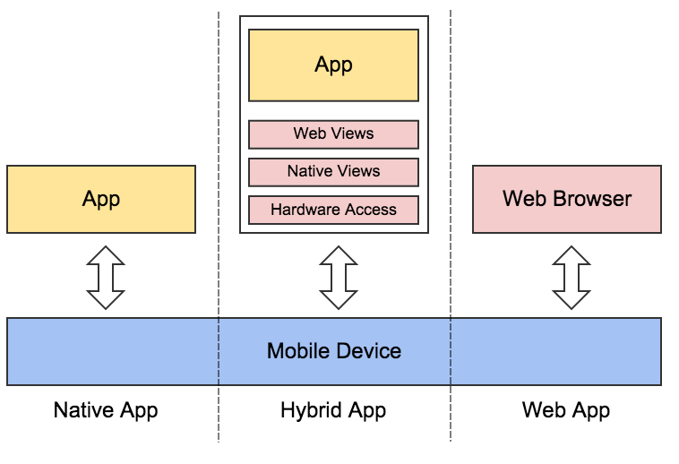
Mobile Architecture Options

Slide 5
Salesforce Mobile SDK
Expedite mobile application development by providing authentication, record syncing, etc.
Allows 3 options:
Native – completely custom implementation in native iOS or Android code
Hybrid Local – completely custom implementation in HTML & Javascript
Hybrid Remote – container of your existing responsive Visualforce-based website
Notes:
Salesforce Mobile SDK helps jump start mobile development
3 types:
- native mobile application
- writing native code for everything
- uses API calls
- hybrid local mobile application (develop app in html/js/css inside the app – files are downloaded locally onto your phone rather than being hosted on salesforce’s server)
- Pure JavaScript Development using API calls
- Easy for Offline
- Fewer Server-side calls for assets
- hybrid remote (points to the responsive Visualforce page from the native app, the shell is provided by an open source project called cordova. Cordova is a way to bridge the gap between the native features of your device with functionality written in expose html/javascript rather than native code)
- Easy access to Visualforce
- Possible to avoid API calls
- Difficult for Offline – Requires HTML5 Manifest
Hybrid remote solves the distribution issue, the branding issue, and the single code base. And there isn’t even any code involved…

Slide 6
Basic Setup Requirements
For iOS:
Mac Computer with Xcode
For Android:
Eclipse or Android Studio
Android SDK Tools
Android Emulator
For guided installation:
Node.js & Node Package Manager (npm)
Notes:
The setup is very similar for iOS or Android. We’ll walk through iOS today, but each step has a corresponding Android step.
iOS is a little easier to set up because Xcode handles everything; Android requires some independent environment setup for SDK and emulator
Node package manager (npm) is leveraged for the command line interfaces, and can be downloaded along with the node.js installer
Salesforce provides a tool called forceios which is a node-based wizard that bootstraps the creation of a complete xcode or android project for you based on cordova

Slide 7
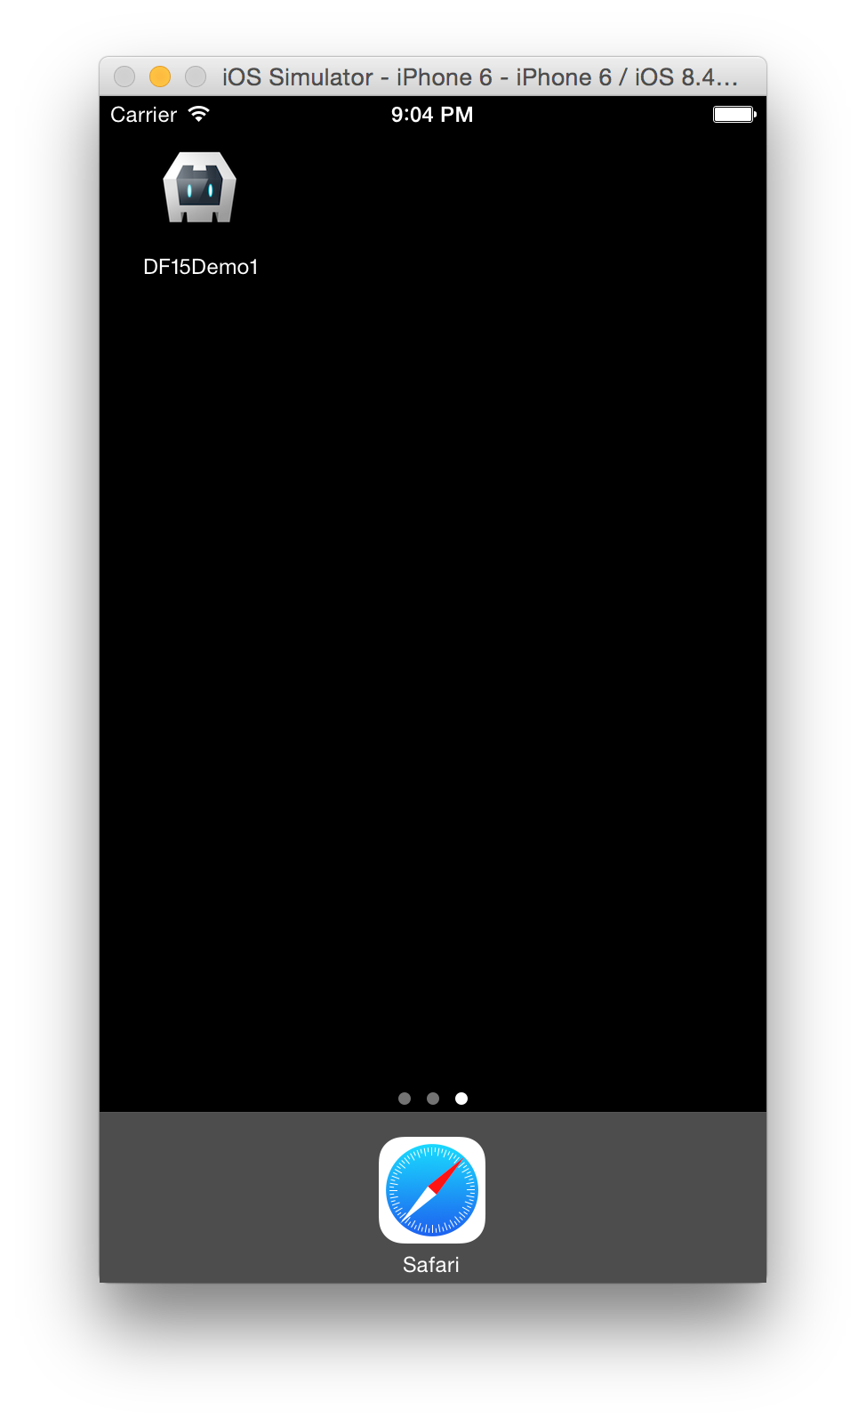
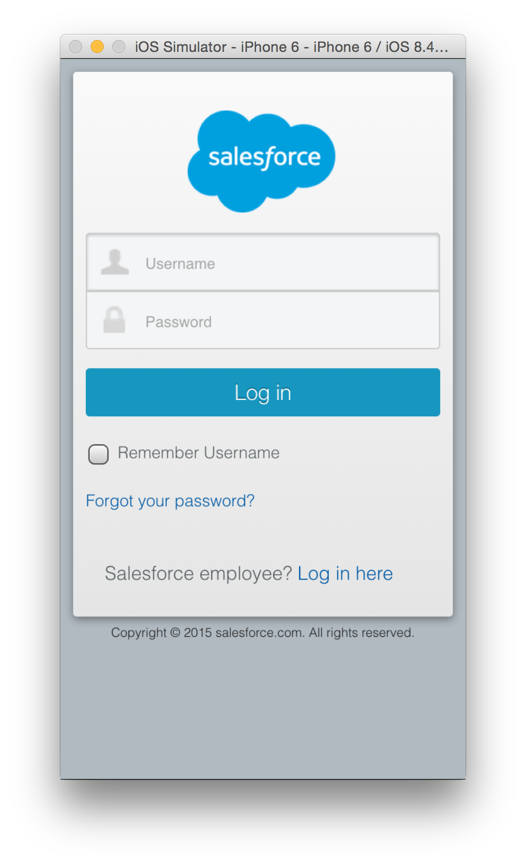
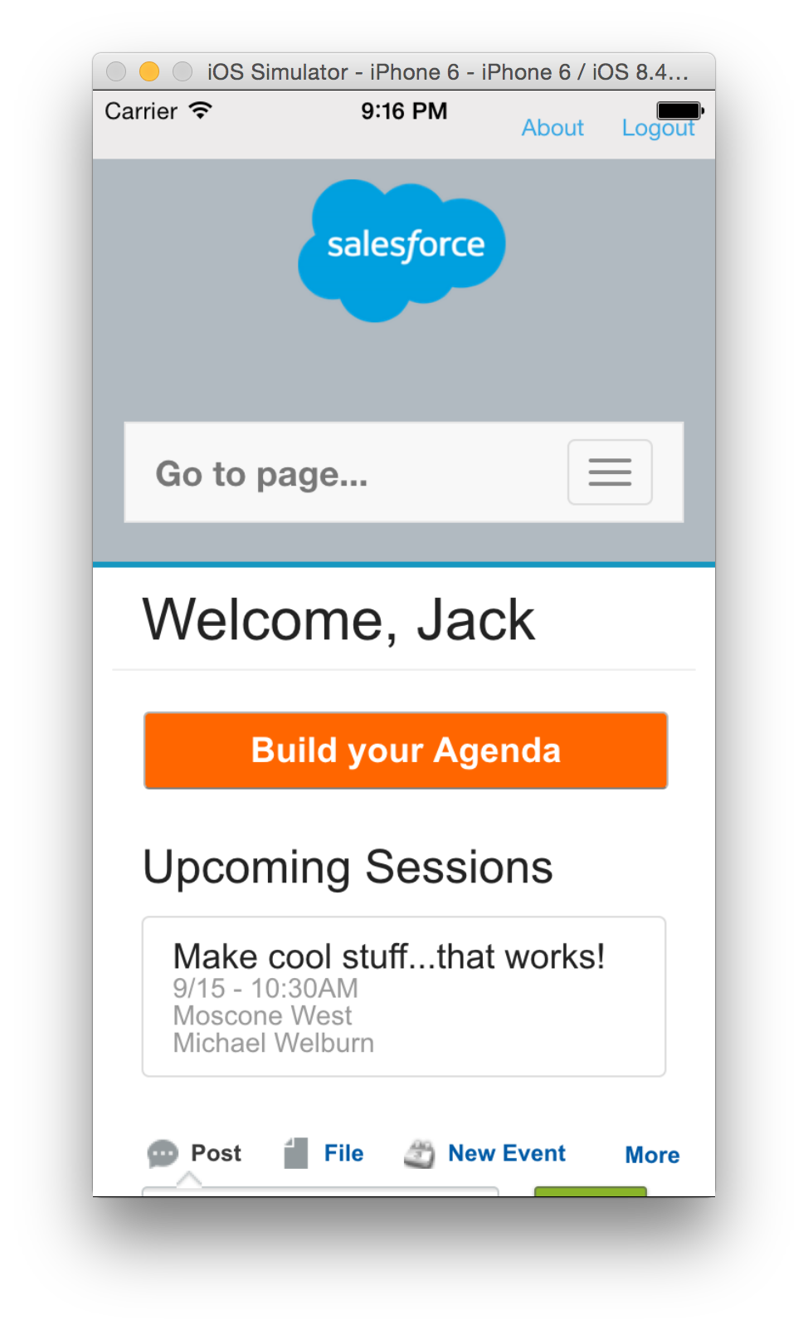
Mobile SDK Demo
Notes:
First we need to do some housekeeping on the Salesforce side, in particular creating a connected app
Connected app is a way to register your application with salesforce, since the mobile app needs to authenticate remotely from outside of salesforce
https://developer.salesforce.com/docs/atlas.en-us.mobile_sdk.meta/mobile_sdk/communities_mobilesdk.htm
- Connected App
- API Enabled
- Profile/Permission Sets are Community Members
Create a connected app in your org (show a developer org) - http://releasenotes.docs.salesforce.com/en-us/summer14/release-notes/rn_mobile_packaging_connected_apps_ga.htm
======================
Setup > Create > Apps
New "Connected App"
- DF15 Demo
Check "Enable OAuth Settings"
- callback URL: testsfdc:///mobilesdk/detect/oauth/done
- Scope: api, refresh_token, web
Mobile App Settings
- Can define the start url in the application configuration
- Ability to PIN protect (require a pin unlock) within the app
- Choose App Platfrom (choose iOS for example)
- Setting the App Version to an arbitrary number (i.e. 1.0)
- Minimum OS Version, likely 1 version back from current (7.0 for iOS)
- App Binary URL: sfdc (used for private apps)
Need to install npm (which comes with the nodejs installer from nodejs.org)
For a fresh install (https://www.npmjs.com/package/forceios)
===================
> npm install -g forceios OR npm install -g forcedroid
Since I have it installed, want to make sure I have latest
============================
> npm update forceios
> forceios create
Enter your application type (native, hybrid_remote, or hybrid_local):
> hybrid_remote
Enter your application name:
> DF15Demo
Enter the output directory for your app (defaults to the current directory):
>
Enter the package name for your app (com.mycompany.my_app):
> com.salesforce.df15demo
Enter your organization name (Acme, Inc.):
> Salesforce
Enter the start page for your app (only applicable for hybrid_remote apps):
> /
Enter your Connected App ID (defaults to the sample app's ID):
>
Enter your Connected App Callback URI (defaults to the sample app's URI):
> testsfdc:///mobilesdk/detect/oauth/done
Once complete, you'll set a set of "next steps" on how to build and run the application.
If you don't want to use Xcode, you'll need to download ios-deploy
> npm install -g ios-deploy OR npm update ios-deploy
> cd DF15Demo
> cordova build
> cordova run
Xcode:
- File > Open
- Choose the .xcodeproj to open under platforms/ios
By default, the chosen URL is login.salesforce.com. For a community, we'll need to replace that with the specific URL to the community.
- For iOS, this is [appname].plist
> vi platforms/ios/DF15Demo/DF15Demo-Info.plist OR /Resources/DF15Demo-Info.plist
Add SFDCOAuthLoginHost as a key, with the community URL as the value. Can use sandbox and production separately
- df15demo-developer-edition.na34.force.com
- For Android, this is servers.xml
Need to ensure the Consumer Key, Callback URI, and OAuth scopes are up to date in www/bootconfig.json
Now that basic functionality is complete, there are some important cordova plugins to make your app work seamlessly.
- StatusBar allows your iOS app to have the status bar at the top with the clock
- InAppBrowser lets you display links in a popover (so you don't redirect off of your community without a way to get back)
- Calendar allows you to create calendar events on your phone
> cordova plugin add org.apache.cordova.statusbar
Navigate to config.xml to configure additional values (reference documentation)

Slide 8
Files to Modify
Salesforce modifications:
Connected app – used during the authentication process
API Enabled – profile or permission set
Community Members – add profile or permission set of users to Community
Mobile application files to modify:
[appname].plist – denotes the community URL you are authenticating against (iOS)
servers.xml – denotes the community URL you are authenticating against (Android)
bootconfig.json – basic configuration of your application starting behavior and connected app
config.xml – configuration of plugins, application security, etc.
Notes:
To capture the changes that we made:
- Created a connected app
- modified the reference to the community url in configuration
- updated the reference to the start url, client secret, and oauth scopes
- reviewed any configuration changes for cordova plugins
https://developer.salesforce.com/docs/atlas.en-us.mobile_sdk.meta/mobile_sdk/communities_mobilesdk.htm

Slide 9
Cordova
Cordova plugins will enhance the experience without requiring additional code, and can be searched at the Cordova Plugin Registry (http://plugins.cordova.io)
Recommended plugins:
StatusBar (http://plugins.cordova.io/#/package/org.apache.cordova.statusbar)
InAppBrowser (http://plugins.cordova.io/#/package/org.apache.cordova.inappbrowser)
Calendar (http://plugins.cordova.io/#/package/nl.x-services.plugins.calendar)
Notes:
Cordova plugins are useful ways to build out functionality for your app. The plugin ecosystem is very rich, and many plugins grant access to native parts of the phone including access to geolocation, accelerometer, photos, etc,
A few of them may be table stakes for a user:
- Don’t want a user to navigate off of your site if you don’t present a back button (inappbrowser)
- May want the iOS status bar to show up
Others may be enhanced features
- ability to add a calendar event to your phone
Note that some cordova plugins are built to interact with the APIs available on the phone, but require some javascript to be written on your responsive website to fully enable the functionality. No phone specific code though.

Slide 10
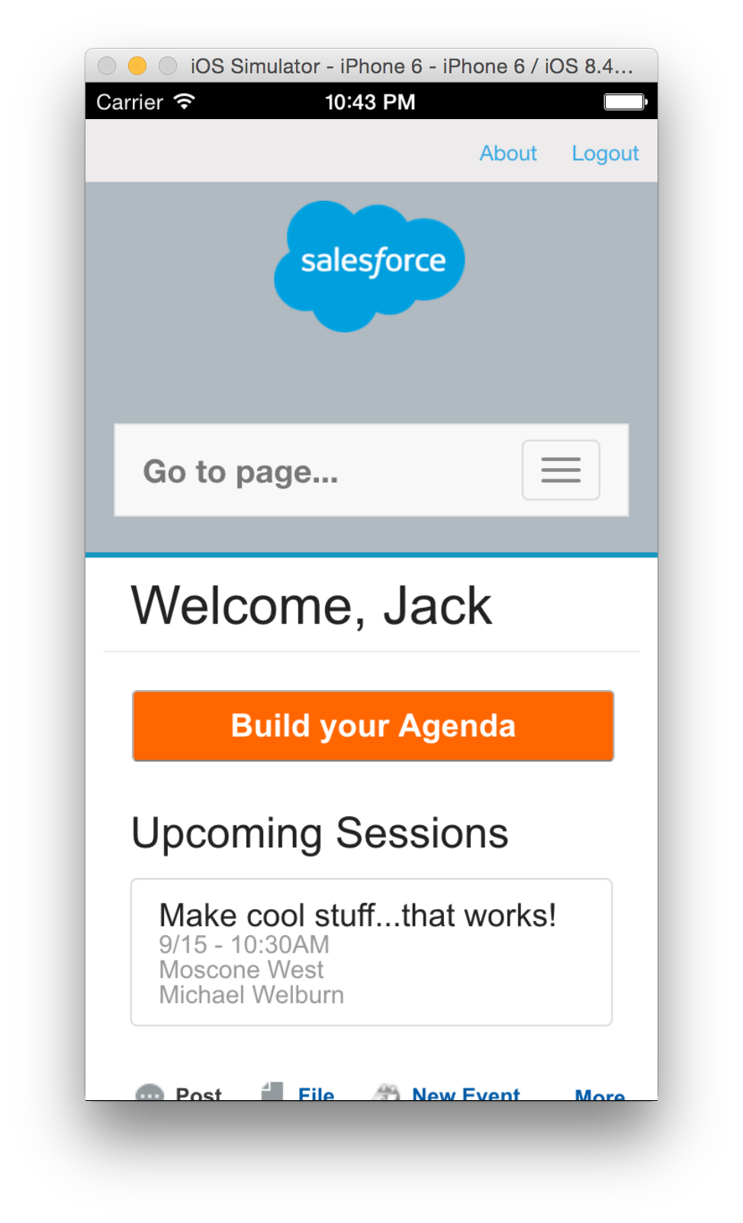
Cordova Plugin Demo

Slide 11
Implementation Summary
Leverage forceios and forcedroid to bootstrap your installation
Choose the hybrid_remote option
Configure the necessary files in the mobile application
Ensure you update the server URL to your community
Install applicable cordova plugins
Update any icons or background images for your application prior to an official deployment

Slide 12
Reference Links
Trailhead: Developer Trail – Mobile SDK: https://developer.salesforce.com/trailhead/trail/mobile_sdk_intro
Salesforce Mobile SDK Home: https://developer.salesforce.com/page/Mobile_SDK
Salesforce Mobile SDK Development Guide: https://developer.salesforce.com/docs/atlas.en-us.mobile_sdk.meta/mobile_sdk/
Node Package Manager: https://docs.npmjs.com/getting-started/installing-node
forceios: https://www.npmjs.com/package/forceios
forcedroid: https://www.npmjs.com/package/forcedroid
Cordova Plugin Registry: http://plugins.cordova.io/

